Slide 1

European Commission
DG ECHO
Disaster risk management
Peer Review Programme
Thomas de Lannoy
DG ECHO A.3 Disaster Risk Reduction
Thomas.de-lannoy@ec.europa.eu

Slide 2
Purpose of EU peer reviews
Support tool for prevention and preparedness under the EU Civil Protection Mechanism, also included in Sendai Framework
Promote an integrated approach to disaster risk management, linking risk prevention, preparedness and response actions
Peer reviews are interactive: mutual learning, exchange of best practice, policy dialogue

Slide 3
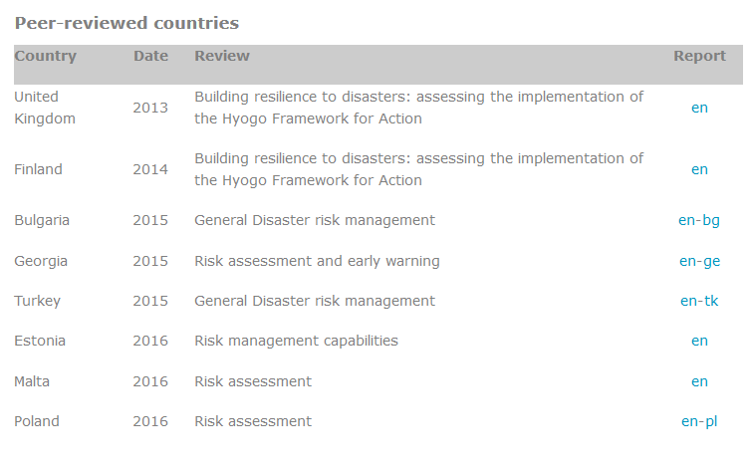
EU peer review history
Pilot reviews EU/UNISDR/OECD
Source: DG ECHO: http://ec.europa.eu/echo/what-we-do/civil-protection/peer-review_en
Notes:
A

Slide 4
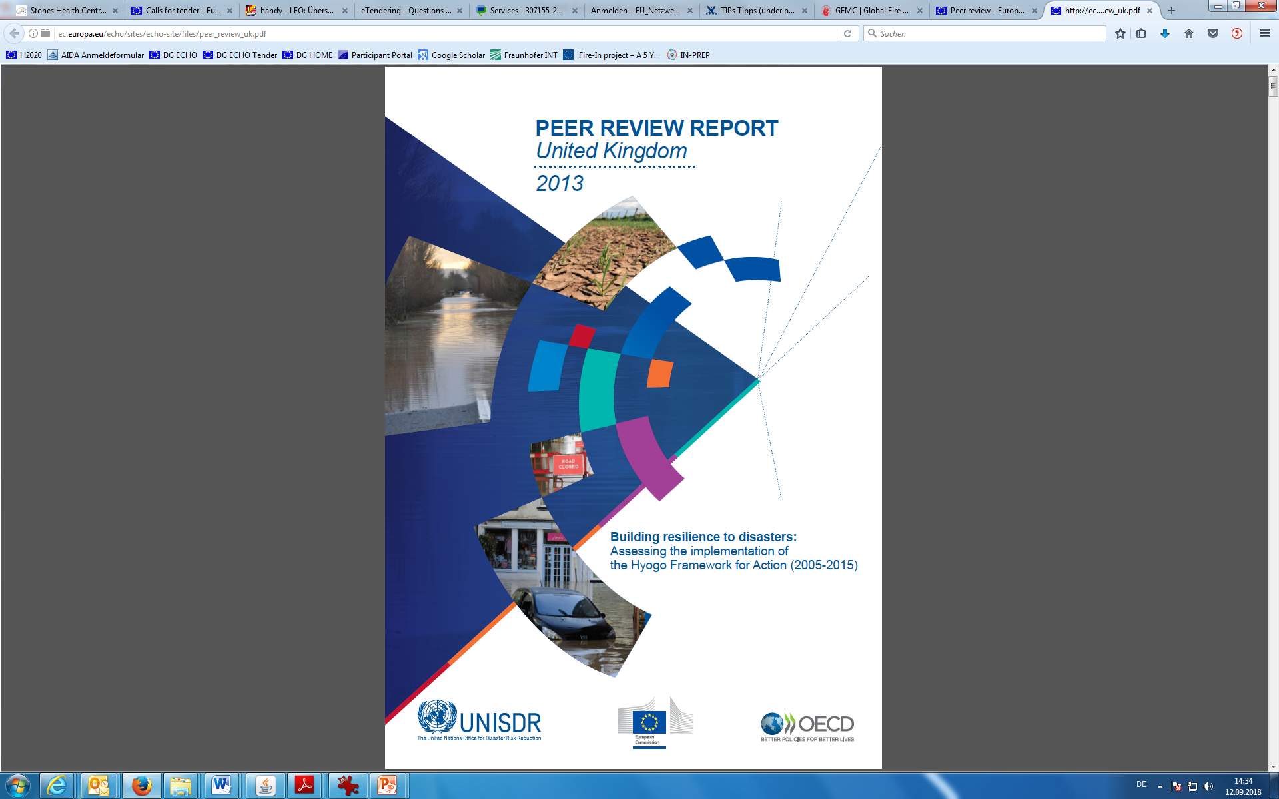
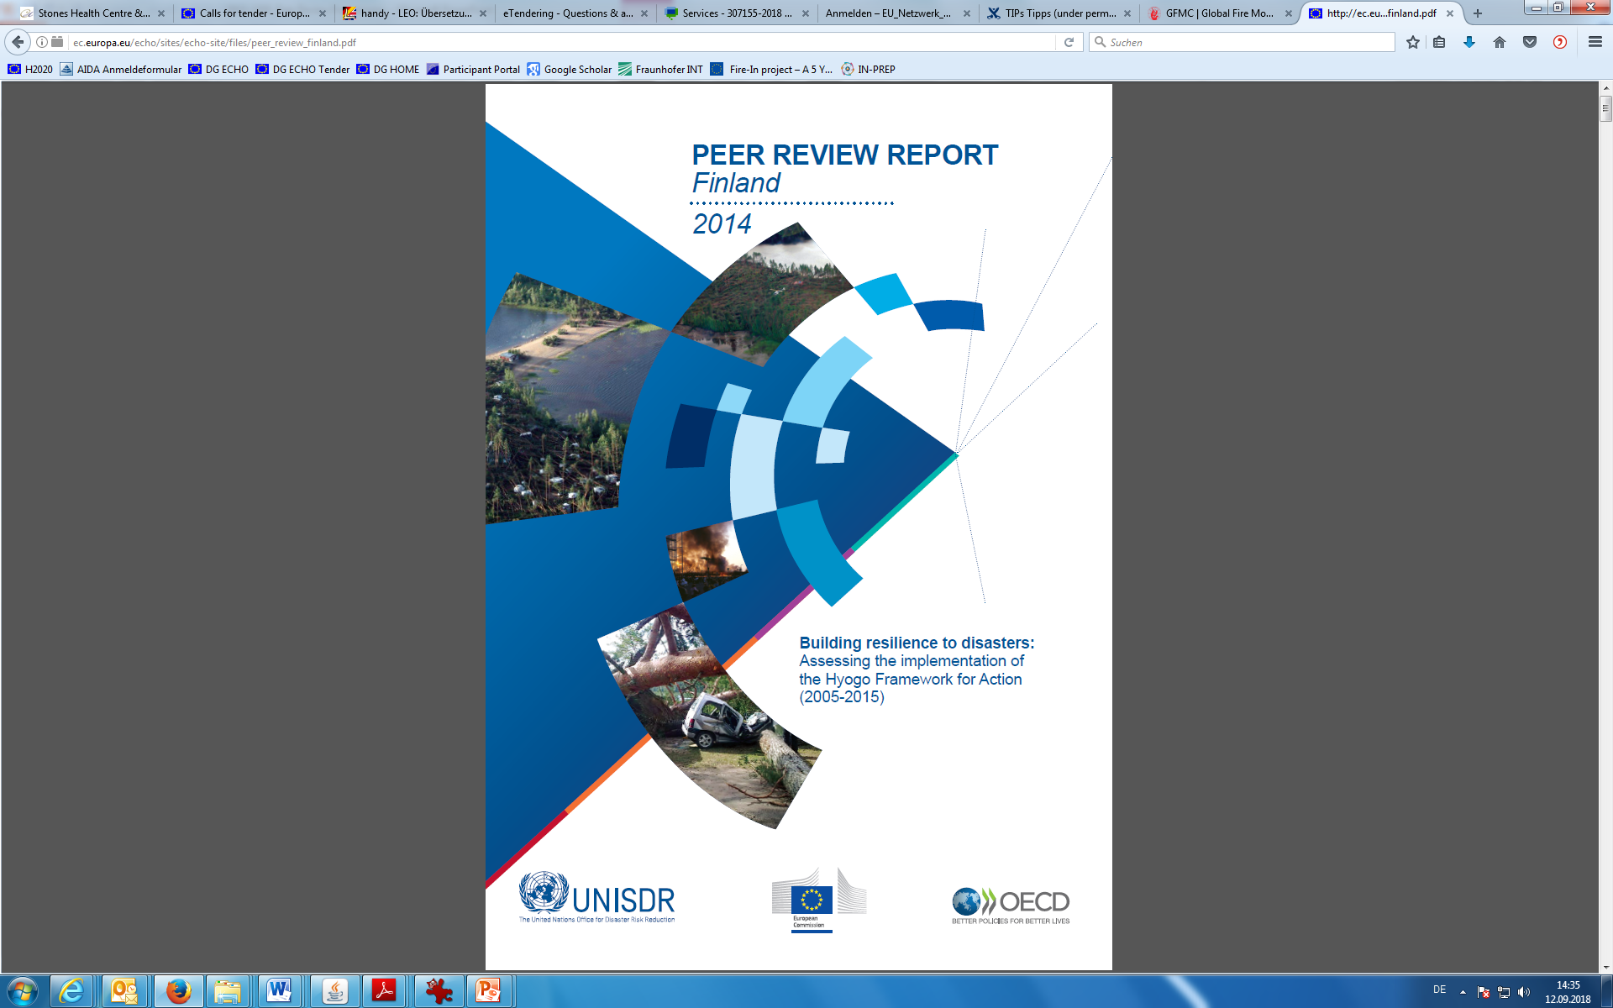
Peer review history – pilot reviews on HFA implementation
Notes:
A

Slide 5
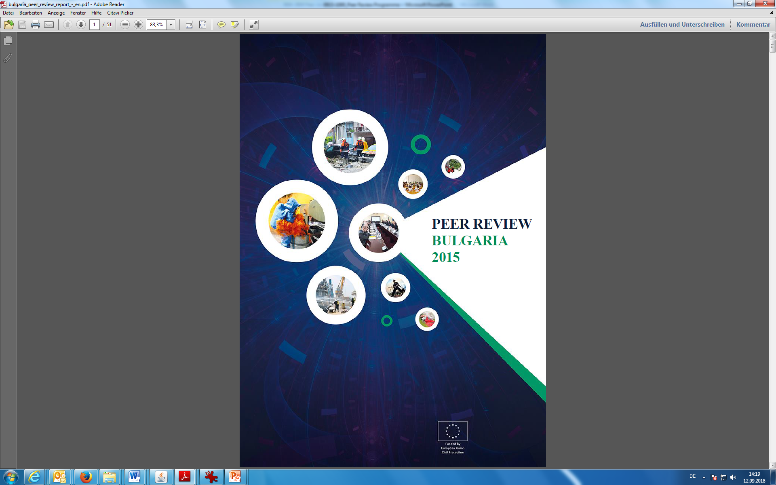
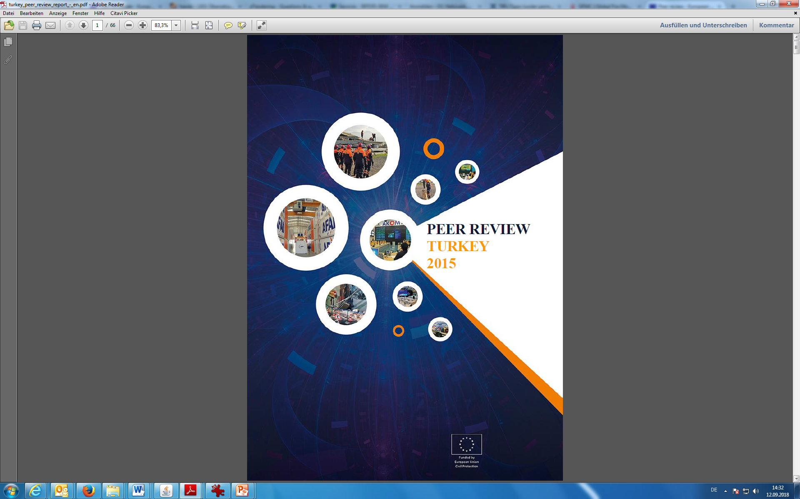
Peer review history – general reviews
Notes:
Develpoment/Introduction of the Sendai Framework in 2014/2015

Slide 6
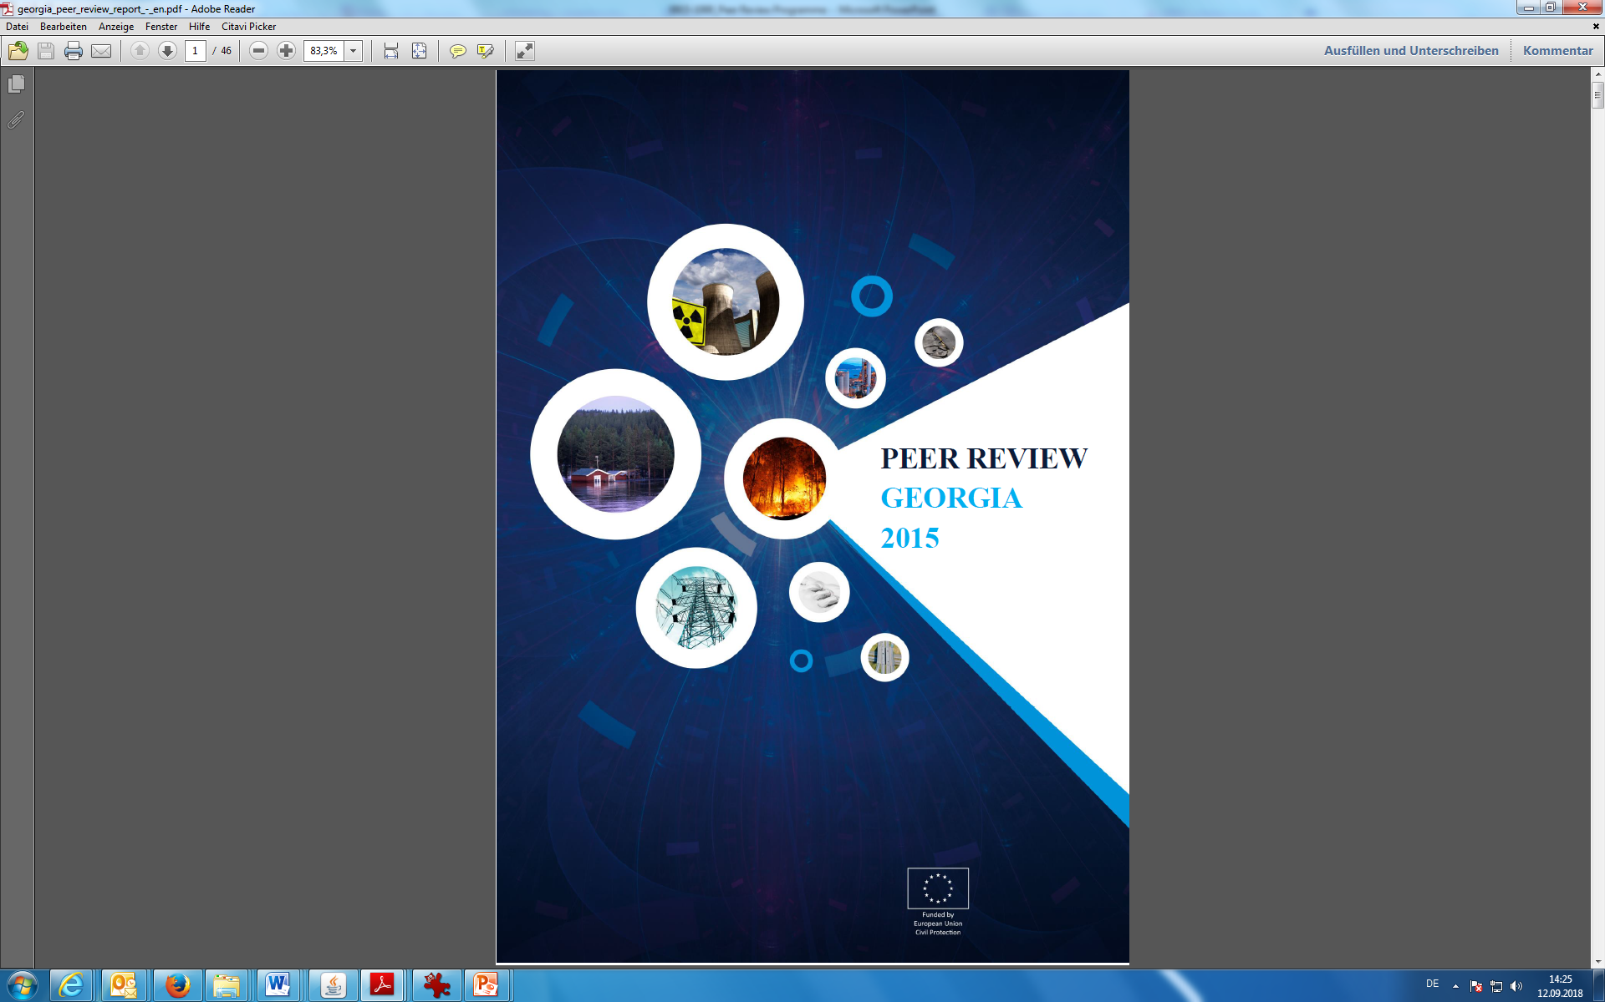
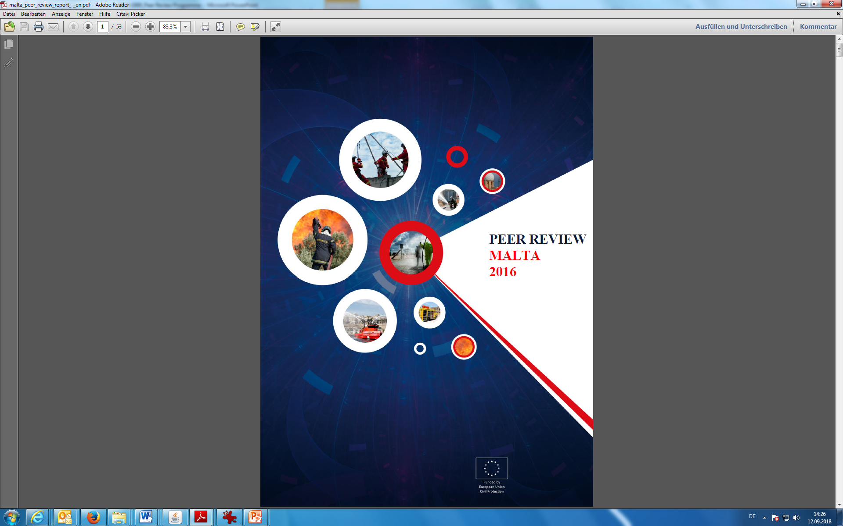
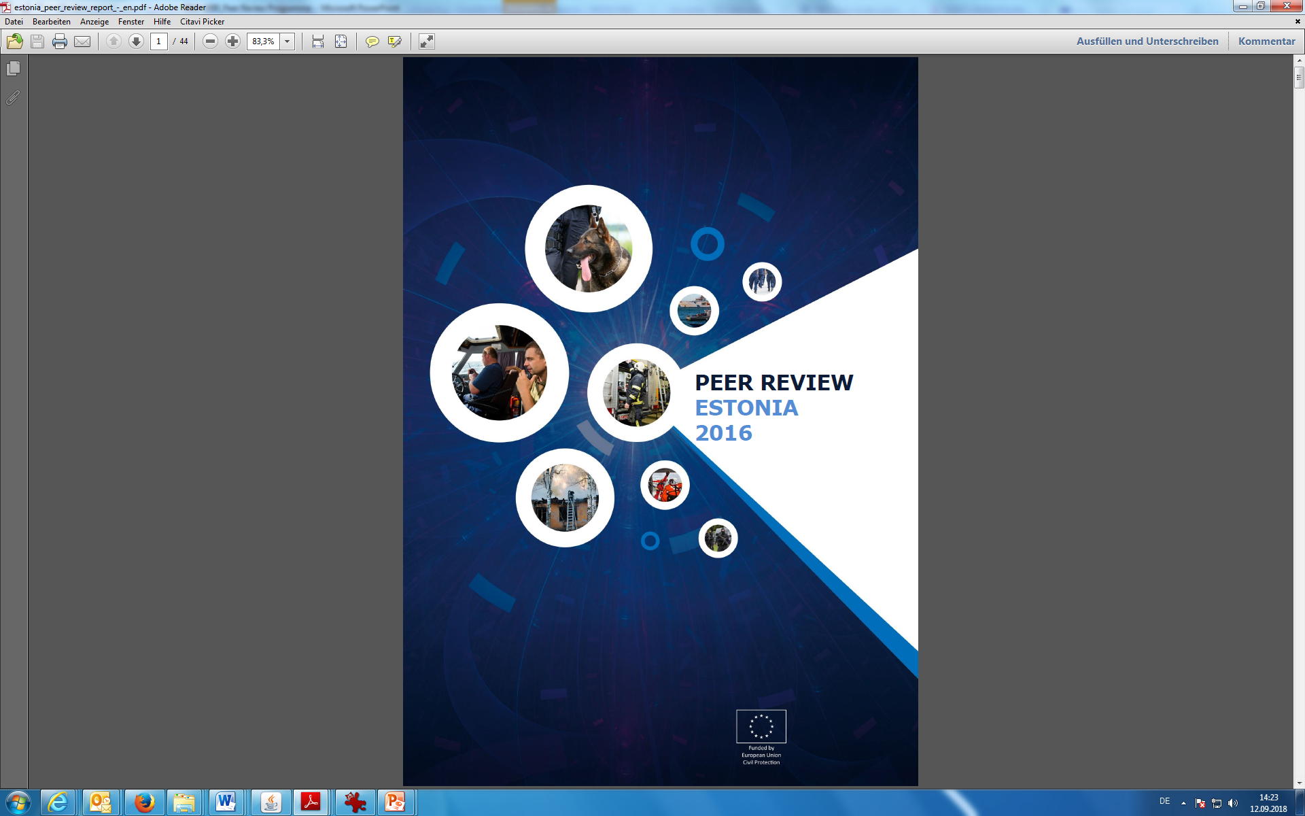

Peer review history – thematic reviews
Risk assessment and
early warning
Risk assessment
Risk management capabilities
Risk assessment
Notes:
A

Slide 7
Peer Reviews 2018-2019
All reviews include a comprehensive disaster risk management element and a visit to the sub-national level;
Prevention (Risk Assessment, Risk Management Planning) and preparedness are either addressed jointly (General Review) or separately and in-depth (Thematic Review);
Planning:
2018: Cyprus, former Yugoslav Republic of Macedonia, Tunisia
2019: Algeria, Portugal, Serbia

Slide 8
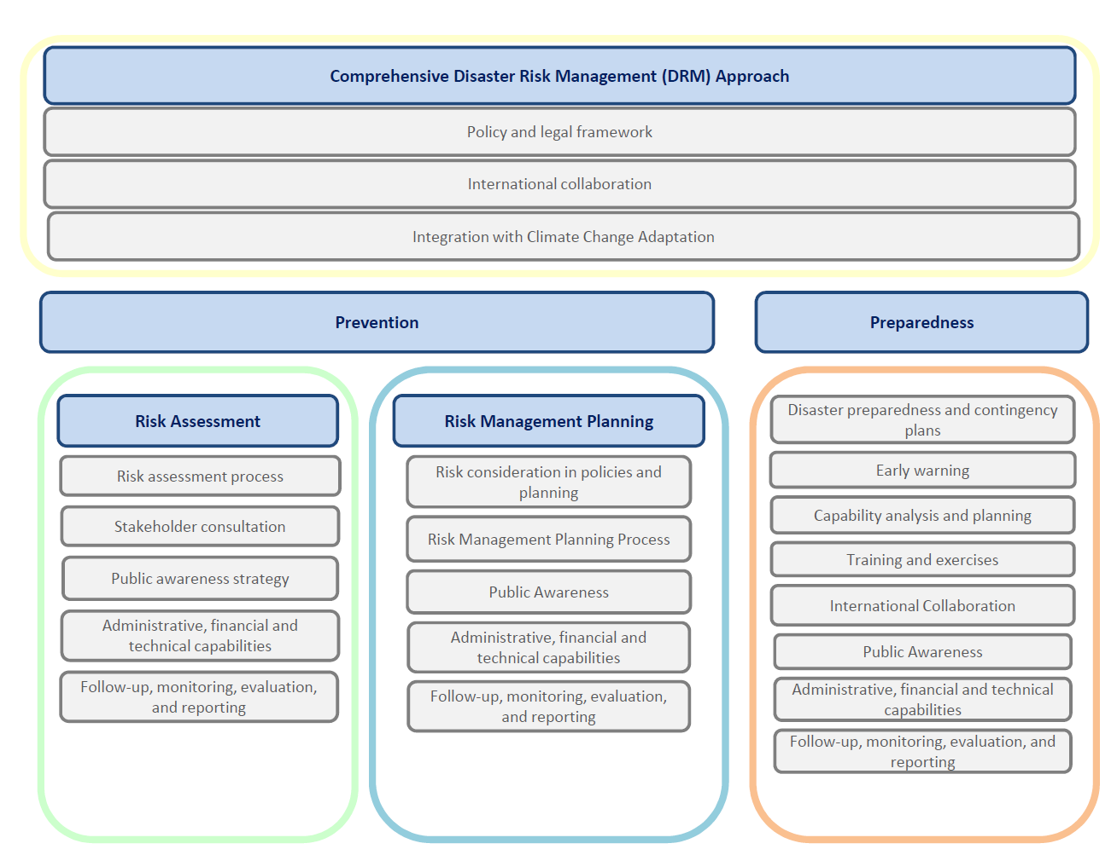
The 2018-2019 Review Framework
Notes:
A

Slide 9
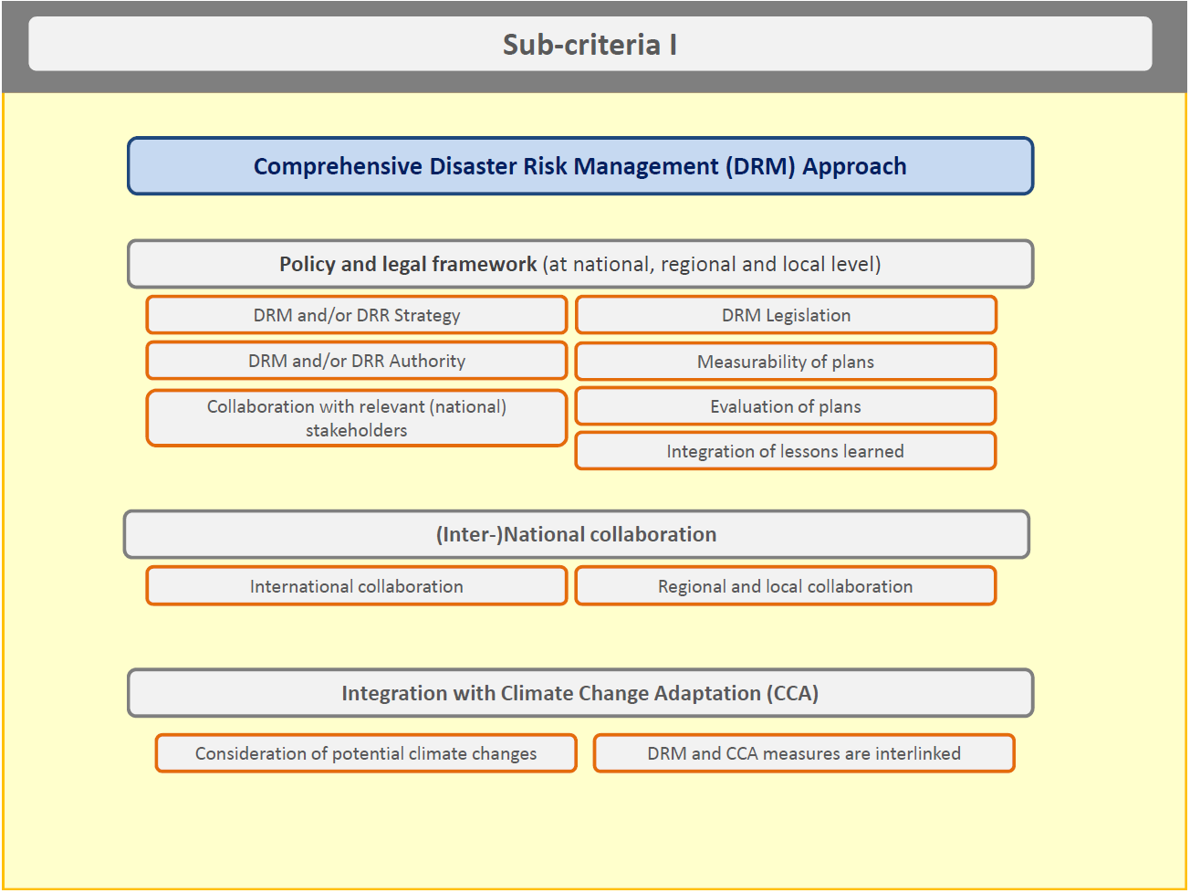
The Review Framework
The framework is further detailed for each category:
Notes:
A

Slide 10
Key roles in peer reviews
Peers = experts that
Assess the disaster risk management system and practices;
Identify best practice;
Make recommendations.
Reviewed country:
Cooperation with third parties (EU and non-EU);
Gather experts’ opinion;
Commit to the process and use results
European Commission (and organising team):
Inform the process by providing policy framework;
Accompany and advise, NOT review;
Quality control
Fund the programme

Slide 11
Post-review impacts and follow-up
Bilateral contacts and exchange of good practice
Validate existing policies and processes, contributing to reforms and DRR reporting
Lessons learnt – to improve process and promote adoption of recommendations
Link to other EU programmes
2020 +
Notes:
Examples of use: reform of system in Bulgaria, submission of risk management capability report under UCPM article 6.c) by Estonia, reforms in Poland and Malta ‘approved’

